Slide 1


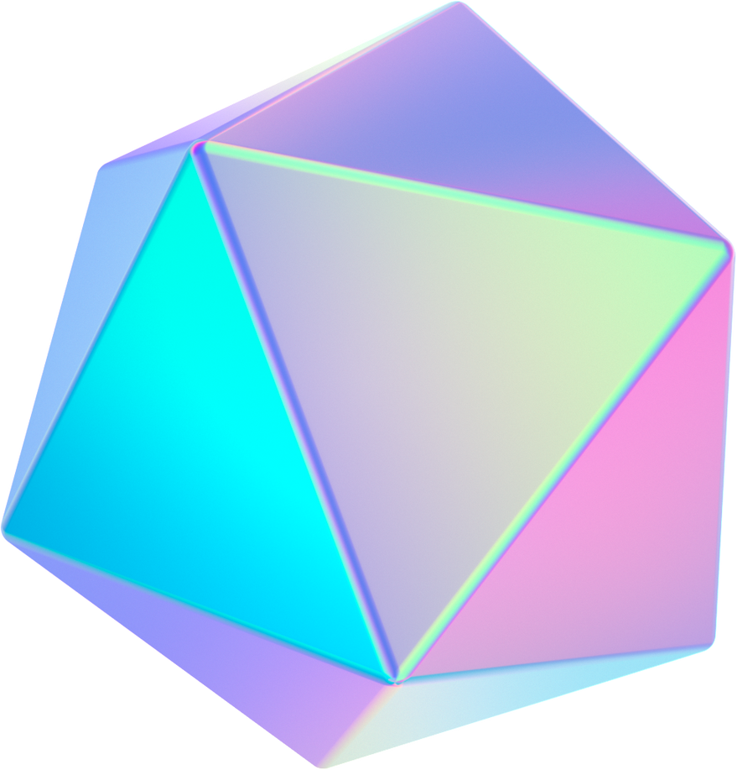




Intelligent Chatbot-Jarvis
PG Group-001
Aman Seth
Ata Uzgoren
Joshua Newton

Slide 2




AGENDA
3-System Architecture
2-Actual GUI Design
4-Main Features
1-Concept Design
5-Evaluation

Slide 3
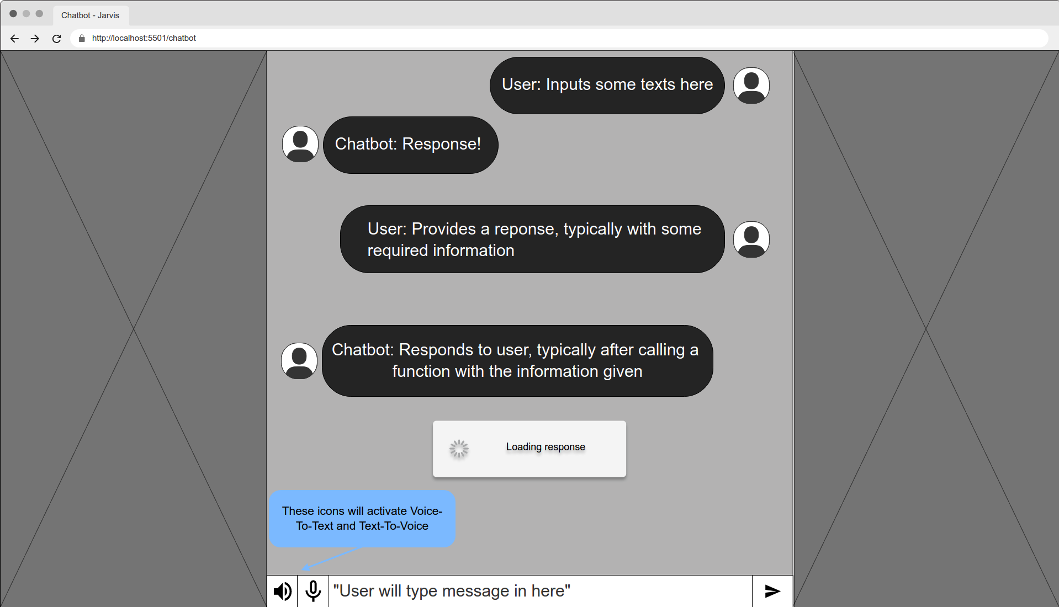

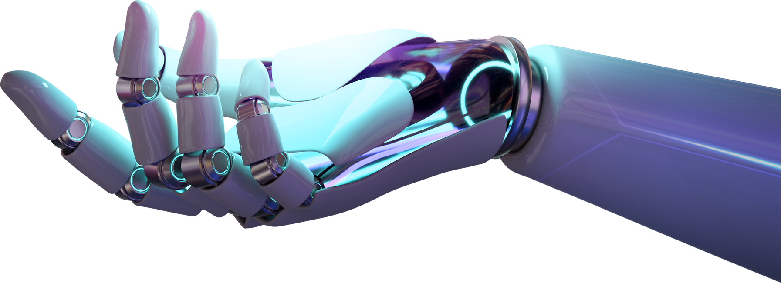
Concept Design

Slide 4
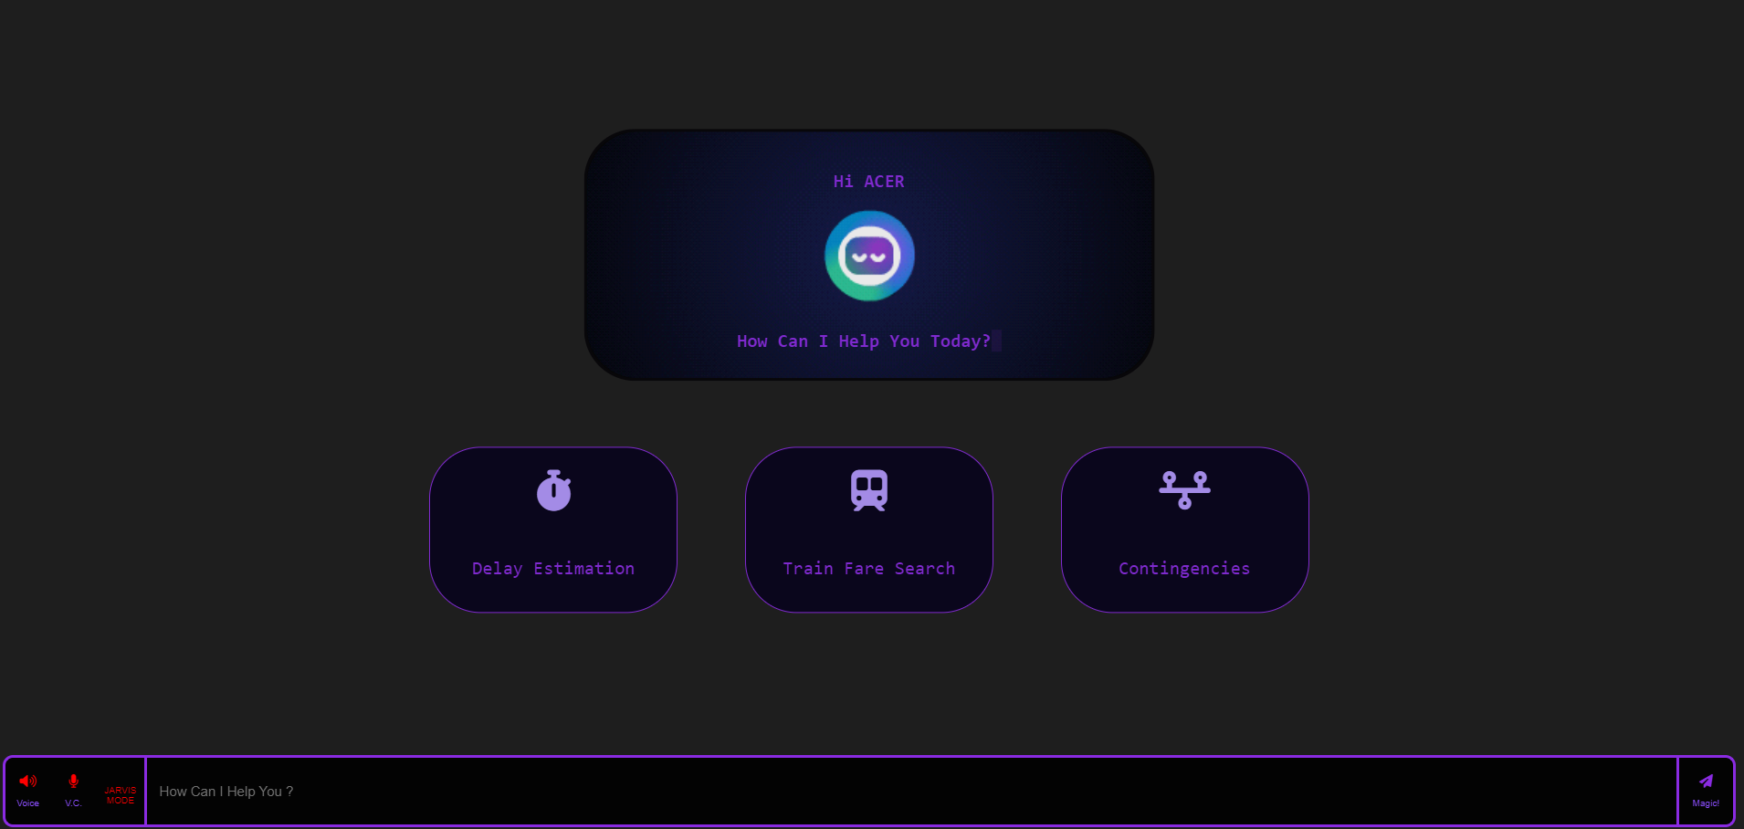
GUI Design-Welcoming
Eye-Catching Details
Personalised welcoming message
Shortcut buttons

Slide 5
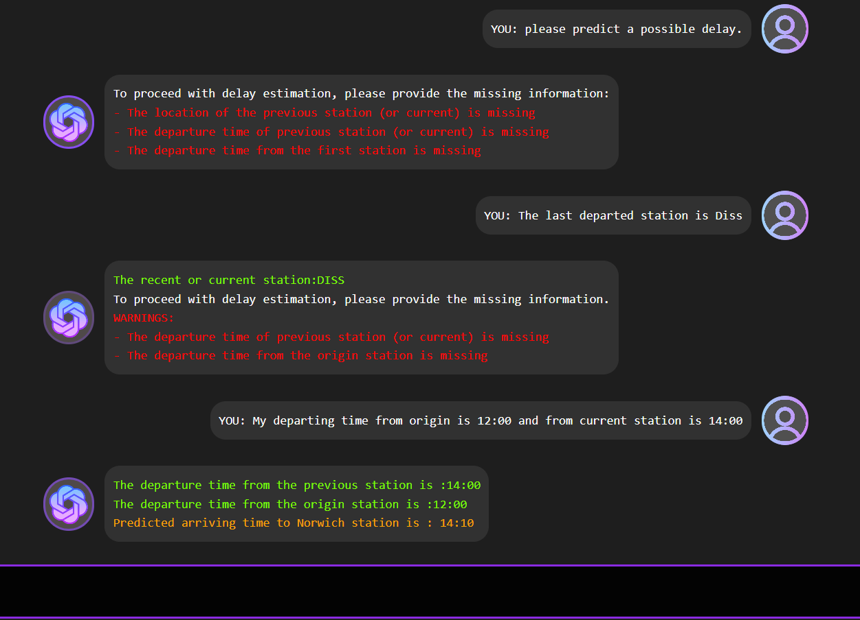

GUI Design-Conversation
Features
Provides overall vital information
Predicts train delay and return time
Appropriate message color coding

Slide 6
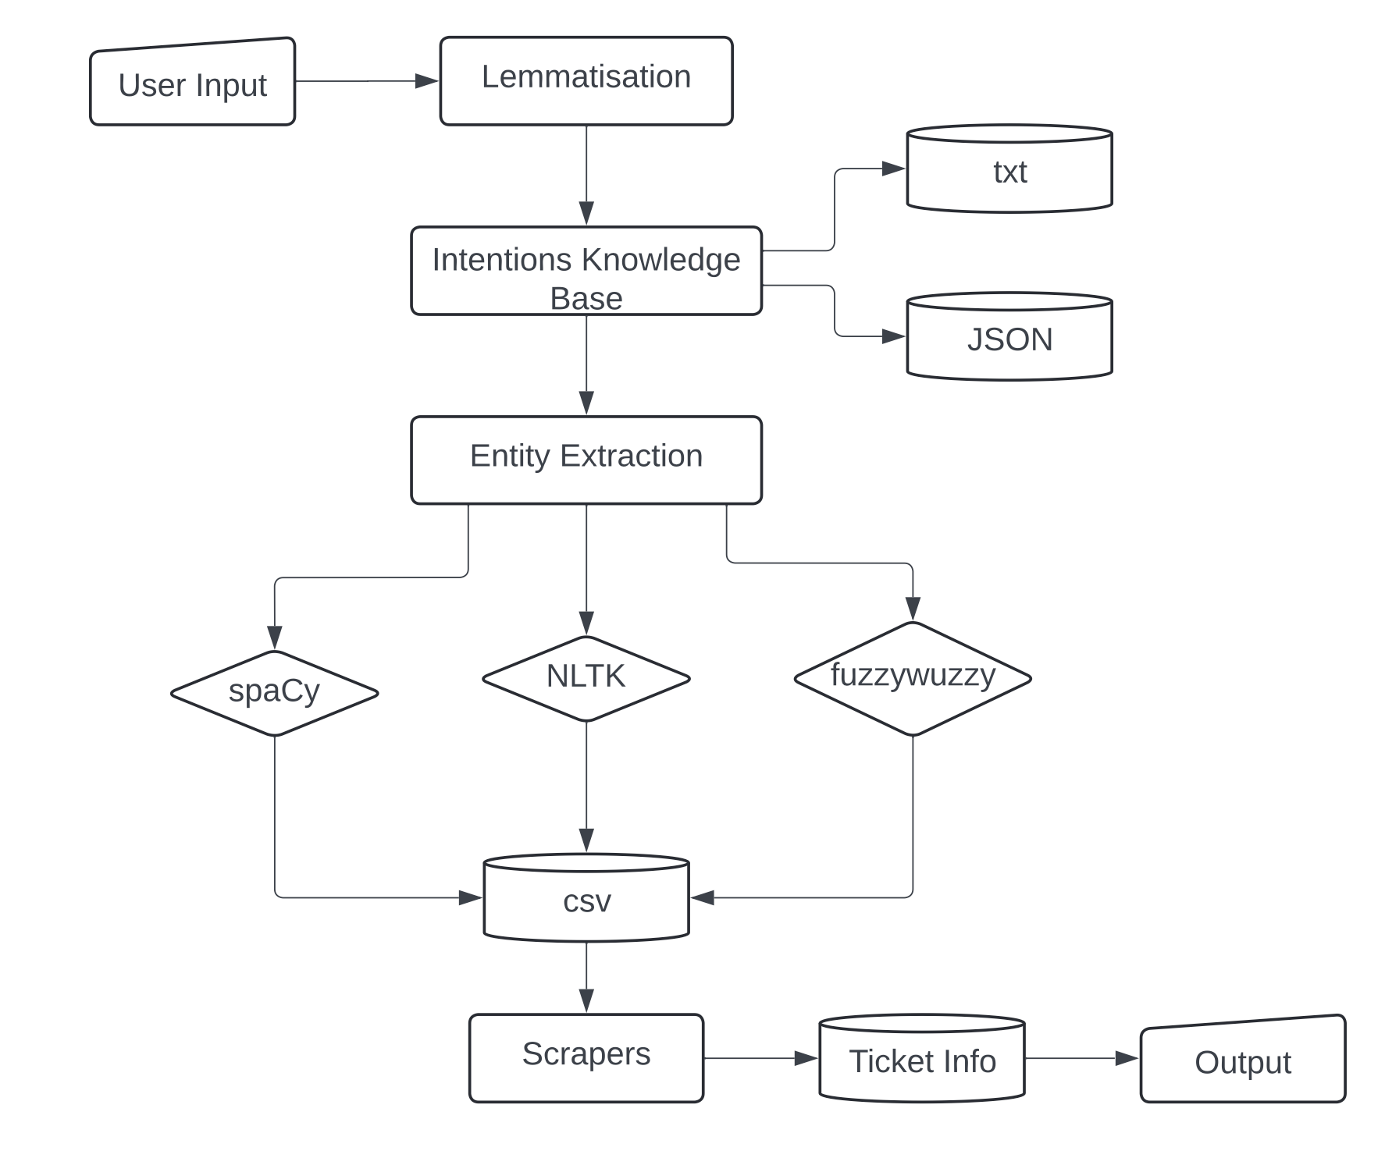
Architecture-Part A

Slide 7
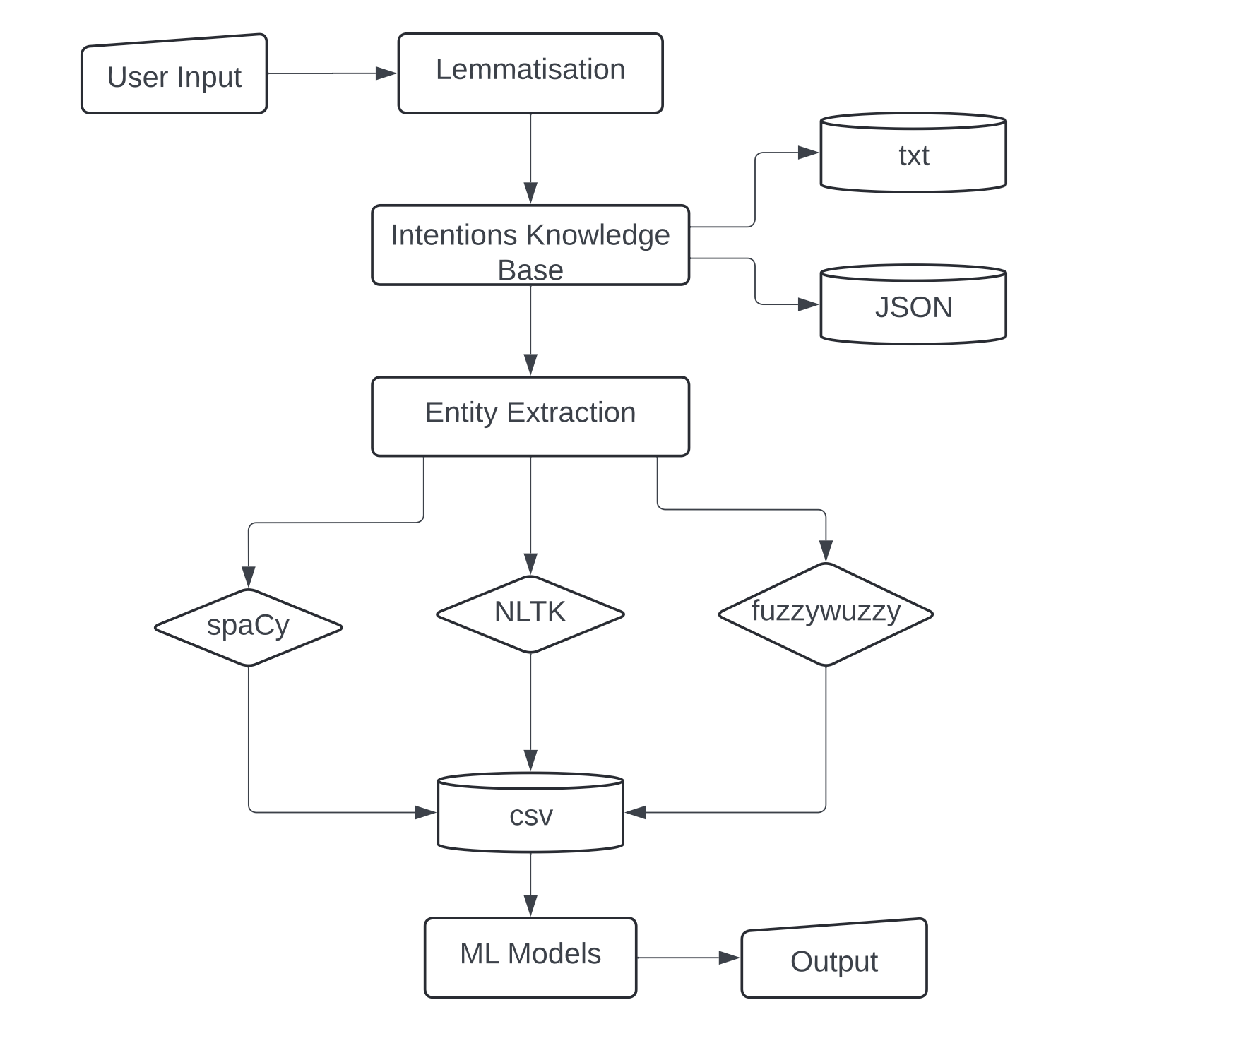
Architecture-Part B

Slide 8
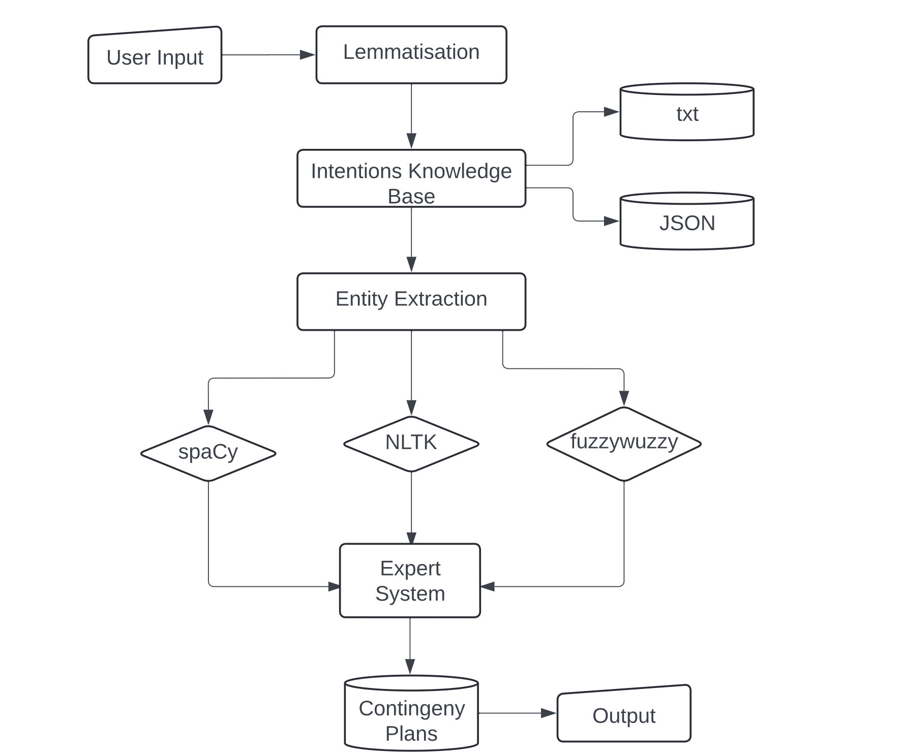
Architecture-Part C

Slide 9



Main Features
Cheapest Fair Search Mechanism
Delay Estimation Mechanism
Contingency Plan Mechanism
4 API-based web scrapers
3 selenium-based web scraper
Concurrent running mechanism
Fare Comparing Mechanism
Progressive Conversation
Random Forest Regressor
K Nearest Neighbors Regressor
XGBoost Regression
Average Predicted Time
Progressive Conversation
70 contingency plan
Different action plans along the red line.
Easy to Use
Progressive Conversation

Slide 10




Evaluation
Usability Tests
Unit Testing
Integration Tests
Usability tests were conducted to ensure Jarvis provides an intuitive, user-friendly experience. This makes it easy for users to find train fares, estimate delays, and access contingency plans efficiently.
Comprehensive unit tests were performed to verify the functionality and reliability of Jarvis's core features, including fare searches, delay estimations, and contingency plan generation.
Integration tests with the GUI were executed to confirm that Jarvis's user interface works smoothly with its backend systems, providing users with accurate and timely fare searches, delay estimations, and contingency plans in a user-friendly manner.

Slide 11



Demonstration…

Slide 12
ONE MORE THING...

Slide 13


Thank You!
Any Questions?

